Slide 2
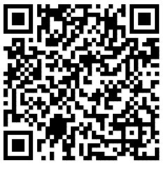
About ESREA
ESREA is a non-profit organisation established in 1992, and governed under the German law (since 2019).
It is steered by the 12 elected members of the Steering Committee and supported by the Secretariat located at the German Institute for Adult Education (DIE) in Bonn, Germany.
Chair: Marcella Milana; Vice-Chair: Fergal Finnegan; Secretary: Susanne Lattke
ESREA aims to:
Support the advancement of high quality research on the education and learning of adults in European countries and beyond
Promote and disseminates meaningful research through networks, conferences and publications
Sustains the development of early career researchers and PhD students through dedicated events, seasonal schools and bursaries

Slide 3
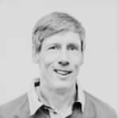
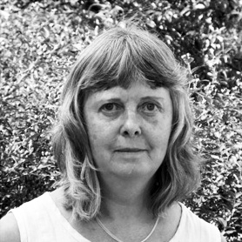
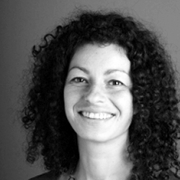
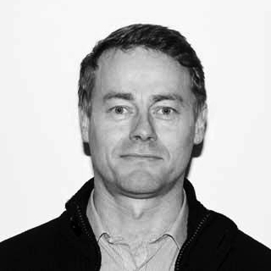
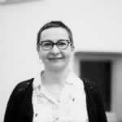
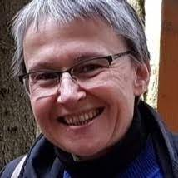
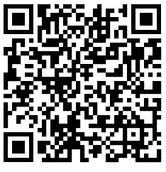
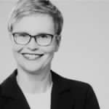
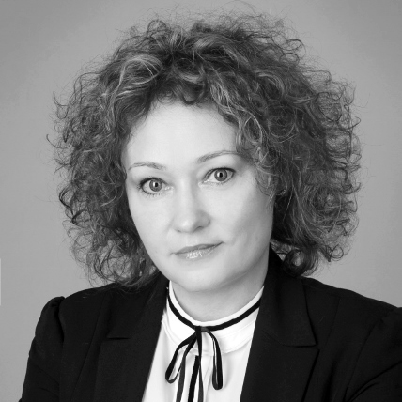
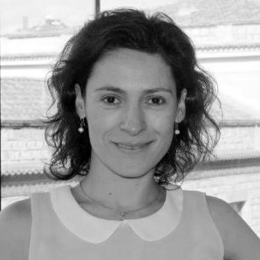
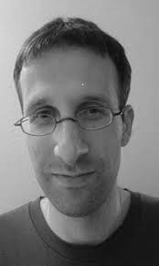
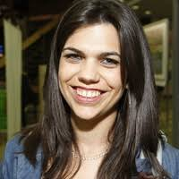
Steering Committee
and Secretary

Slide 4
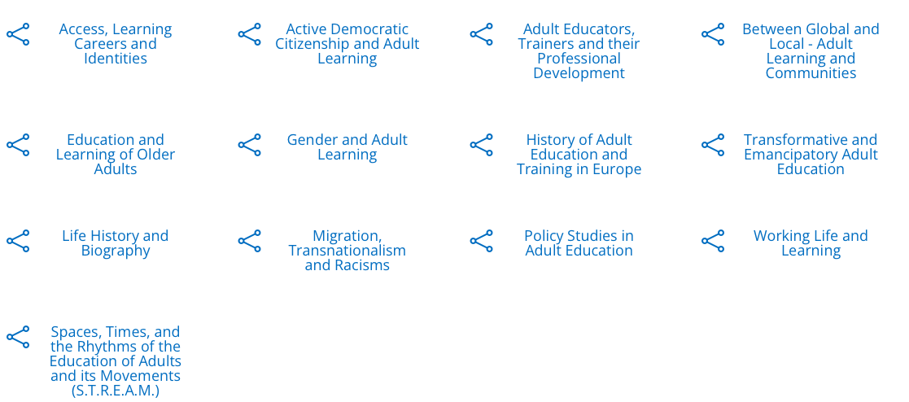
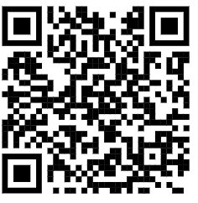
ESREA Research Networks
ESREA main work is organised in 13 thematic research networks that hold regular meetings

Slide 5
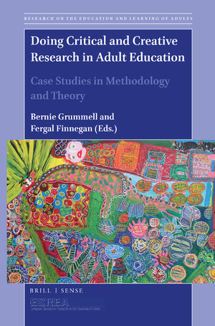
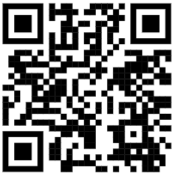
Open Access Book Series Research on the Education and Learning of Adults Sense / Brill Publisher

Slide 6
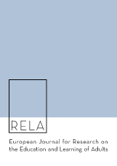
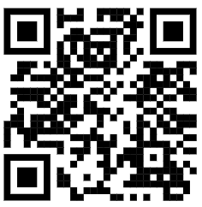
Open Access Journal
The European Journal for Research on the Education and Learning of Adults (RELA)
Refereed academic journal creating a forum for the publication of critical research on adult education and learning.
It receives support from the Swedish research council.

Slide 7
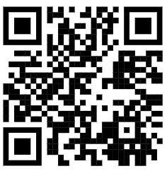
Events
ESREA Network Conferences (annual or biannual)
ESREA Triennial Conferences (ALL NETWORKS)
Summer and Winter schools for PhD students and newer researchers

Slide 8
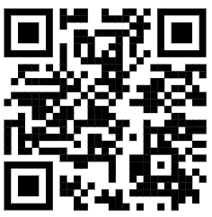
Membership benefits
Access to networks activities
Research and publication opportunities
Reduced fees for all networks and ESREA conferences
A regular newsletter
Updates by email on Calls for papers, job opportunities, etc.
Bursaries for PhD students
A prize for the best paper presented by a PhD student at the triennial conferences
Join us! You sustain our work for the adult education community!

